Slide 1

ElectiViz election type data visualization for media
Presented By SK ROSHAN JAHEER

Slide 2
Problem Statement
In modern democracies, election data is vast, complex, and rapidly evolving. Media organizations require accurate, real-time, and visually engaging representations of election results to inform the public effectively. However, raw election data is often difficult to interpret quickly without structured visualization.
Data visualization platform that transforms complex election datasets into
1. interactive dashboards, charts, and real-time visual reports.
2. The system should enable media professionals to analyze and present election trends clearly,
3. compare historical and current results, track vote shares and
4. highlight key performance indicators across regions and parties.

Slide 3
Objective of the project
1 To develop an interactive data visualization platform that transforms complex election data into clear and meaningful graphical representations.
2 To provide real-time election result tracking for media organizations to broadcast accurate and up-to-date information.
3 To analyze constituency-wise and party-wise performance using dashboards, charts, and maps.
4 To simplify large datasets such as vote share, voter turnout, and demographic trends into easy-to-understand visuals.

Slide 4
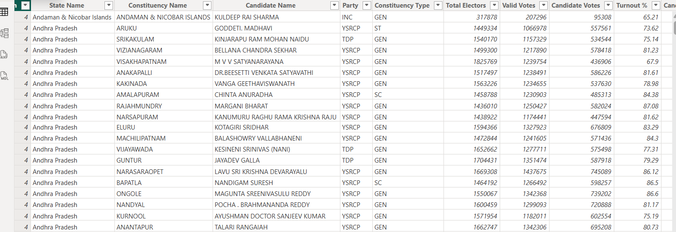
The dataset includes: 1.consistency 2.Total votes received 3.Total no of parties 4.States 5. vote percentage 6. Candidate names 7. Winning candidate and victory margin 8. Vote share percentage
About the Dataset
The dataset used in ElectiViz consists of structured election data collected from official election commission sources and publicly available government records.
It includes detailed information about constituencies, political parties, candidates, vote counts, and voter turnout statistics.

Slide 5
Dataset Integration
Overview
Dataset integration refers to the process of collecting, combining, cleaning, and transforming election data from multiple sources into a unified and structured format suitable for visualization and analysis.
dataset integration ensures that raw election data is converted into accurate, consistent, and real-time ready dashboards for media reporting.

Slide 6
Data Modelling
Data modelling is the process of designing the structure of the election dataset to organize relationships between different data entities such as constituencies, candidates, parties, and results. It ensures efficient querying, accurate analysis, and smooth dashboard performance.
data modelling helps convert raw election data into a structured format suitable for visualization and reporting.

Slide 7
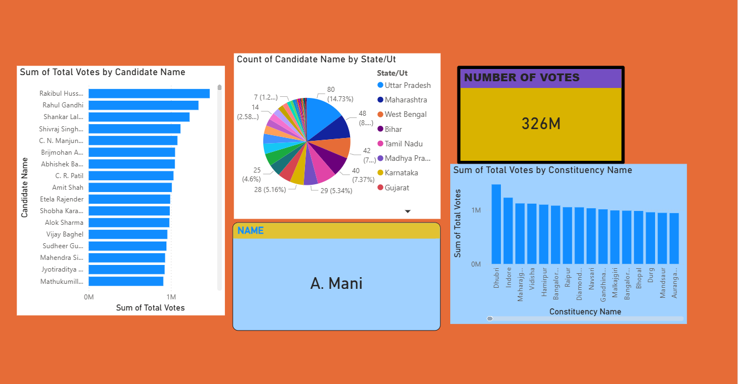
Data Modelling
We used:
1. pie chart - number of candidates per state and their names
2. KPI Card - the name of the candidate and Total number of votes
3. Line and stacked column chart - sum of total votes by constituency name
4. Stacked bar chart - sum of total votes by candidate name.
TO UNDERSTAND:
1. how many votes are gained by the parties, the name of the candidate.
2. the constituency name and the percentage share taken by each state in the pie chart.

Slide 8
Historical Trends
Historical trends analysis focuses on examining past election data across multiple years to identify patterns, changes in voter behavior, party performance shifts, and regional voting dynamics. This helps media organizations present comparative insights and long-term political developments.

Slide 9
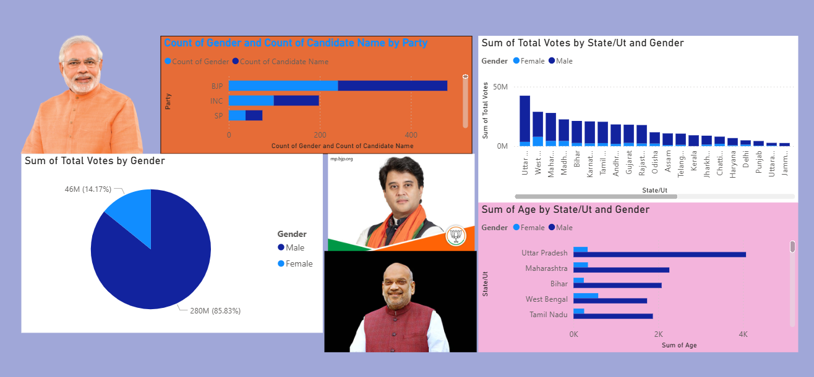
Historic Trends
We used: 1. pie chart - total number of votes per gender. 2. Line and stacked column chart - sum of total votes by state name and Gender. 3. Clustered bar chart - sum of votes for state and the number of male and female votes.
TO UNDERSTAND:
1. how many votes are gained by the states per gender. 2. the percentage of the male and female voters. 3. the number of male and female members in a party.

Slide 10
Real Time Results
Real-Time Results refers to the live tracking and visualization of election data as it is officially announced. This feature enables media organizations to broadcast up-to-date election outcomes with accuracy, speed, and clarity.
live data feeds and automatically updates dashboards to reflect current vote counts, leading candidates, seat tallies, and party performance in real time.

Slide 11
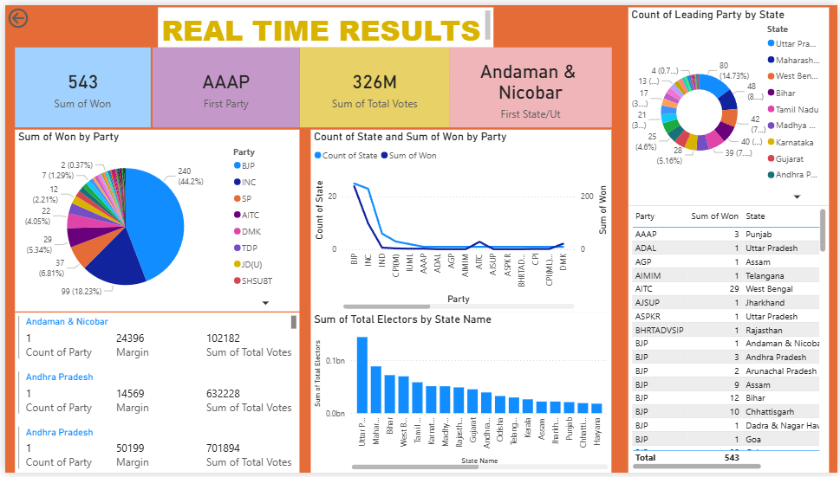
We used: 1. pie chart - sum of the sets won by the party 2. Line chart - sum of seats won by the State 3. Stacked column chart - sum of total electors for State 4. Multirow card – state, no of parties, margin and total votes 5. Table – party, sum of won and the name of the state 6. Donut chart - state and count of leading party 7. KPI card - showing how many seats was won by the specific state and the total votes of the leading party
TO UNDERSTAND:
1. how many votes are gained by the states 2. the leading party 3. the number of seats won and 4. the leading state.

Slide 12
Turnout and demographic analysis
Turnout and demographic analysis in data visualization refers to the process of studying how many people participate in an event (turnout) and the characteristics of those people (demographics) such as age, gender, education, income, and location. This analysis helps understand participation patterns and differences among various groups in a population.
turnout analysis shows the percentage of people who voted, while demographic analysis shows which age groups or regions had higher or lower participation. Together, they help researchers, organizations, and governments understand behavior and improve strategies or policies.

Slide 13
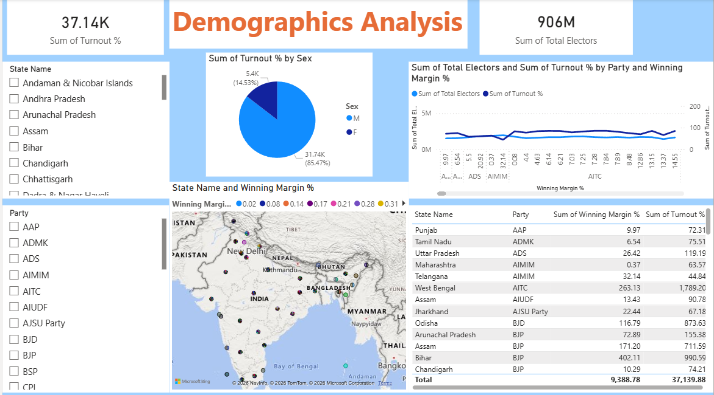
we used: 1. the slicers - state names and party 2. Maps - state name and winning margin 3. Line chart - party name winning margin, total number of votes, total number of turn out percentage and 4. table - state name ,party name ,total winning margin and total turn out percentage 5. Pie chart - turnout percentage for male and female 6. KPI card - total no of votes and total turn out percentage.
TO UNDERSTAND:
the turnout percentage of every party in the particular state.
Percentage of male and female votes.
The percentage of winning margin

Slide 14
Party and candidate performance
Party and candidate performance refers to evaluating how well political parties and their candidates perform in elections based on factors such as the number of votes received, seats won, vote share, and comparison with other parties or candidates. This analysis helps identify which parties or candidates are more popular in different regions or among different groups of voters.
analysts can clearly show the performance of each party and candidate, making it easier to compare results, understand voting patterns, and evaluate election outcomes. It is useful for political studies, campaign strategies, and understanding public support.

Slide 15
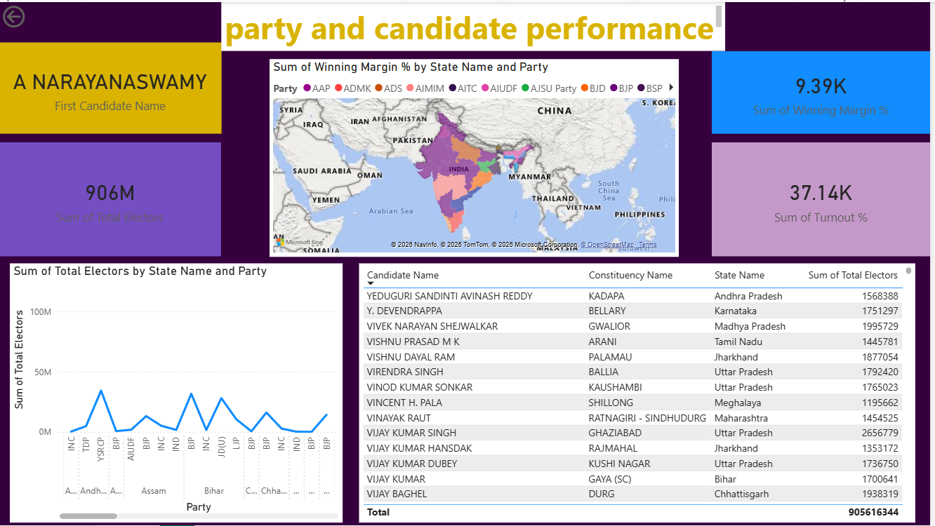
we used: 1. Line chart - state name, part name, total number of notes 2. KPI card - leading candidate, sum of winning margin, total number of votes and the winning margin 3. table - candidate name, constituency name, state name, total number of votes and 4. filled Map – sum of winning margin percentage by state name and party.
TO UNDERSTAND:
party and candidate performance in their respective localities and
the result of their elections.
Leading candidate names and their turn out percentage.

Slide 16
CONCLUSION
Now the Data Visualization is completed and the following are as follows:
1. Data transformation from RAW data to pictorial Data.
2. Understanding of the Large amount of data becomes simplified.
3. It improves the decision making through visual representation instead of RAW numbers.
4. It shows us the Lead and the Least voting parties which makes it easier to understand the party performance on their locality.

Slide 17
THANK YOU

